Slide 1
Breast cancer screening and survivorship
Rachna Raman MD MS
Hematology and Medical Oncology
Bon Secours Cancer Institute at St. Mary’s Hospital

Slide 2
Objectives
Risk factors
Screening guidelines and controversies
Screening and management of patients at high risk for breast cancer
Updates on adjuvant systemic therapy
Survivorship

Slide 3
Average risk of breast cancer
Age- specific probabilities of developing invasive breast cancer
If current age is | Probability of breast cancer in next 10 years | or 1 in
20 | 0.06% | 1,681
30 | 0.43% | 232
40 | 1.45% | 69
50 | 2.38% | 42
60 | 3.45% | 29
70 | 3.74% | 27
Lifetime risk | 12.15% | 8
Breast cancer facts and figures 2011-2012
Notes:
We often hear about the 1/8 risk but this is over a life time and certainly higher in 60s and 70s that at younger agents

Slide 4
Breast cancer risk factors
Relative risk of breast cancer
Notes:
Lifetime risk of breast cancer with BRCA 60%, ONLY 5% breast cancers are BRCA related

Slide 5
Breast cancer risk with breast lesions
No risk | RR 1.5-2 | RR 3-5
Cysts | Papilloma | Atypical ductal hyperplasia
Ductal ectasia | Sclerosing adenosis | Atypical lobular hyperplasia
Fibro adenoma |  | LCIS
Mastitis |  | DCIS
Fibrosis
Arpino G et al. Ann of Int Med 2005
Notes:
Several often diagnosed on biopsy

Slide 6
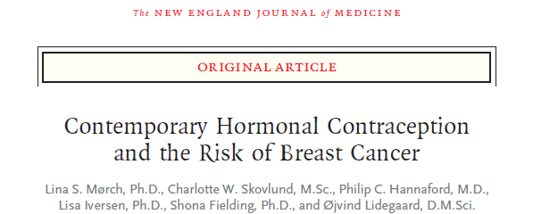
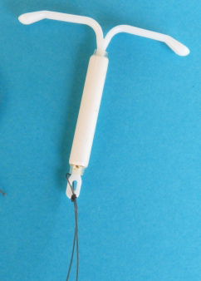
1.8 million women 15-49 y/o who used hormonal contraception followed for 10.9 years
RR for breast cancer with 10 years of use 1.38
RR for progestin IUD 1.21
Risk remained high after stopping if > 5 years of use
1 extra breast cancer for every 7690 women using hormonal
contraception for 1 year
NEJM 2017
Notes:
Prospective cohort study. Risk also increased with progestin only pills especially Levonorgesterol

Slide 7
Breast cancer risk factors
Relative risk of breast cancer
Notes:
Lifetime risk of breast cancer with BRCA 60%, ONLY 5% breast cancers are BRCA related

Slide 8
Screening
Screening average risk (Life time risk < 15%)
Controversies
Increased risk populations (Life time risk > 20%)
Hereditary breast cancer and genetic testing
Screening in increased risk
Breast MRI
Risk reduction in increased risk populations

Slide 9
Screening for average risk
Cancer Prevention Group | Age 40-44 | Age 45-54 | >50-55
American Cancer Society | Individualized decision | Annual | Switch to every 2 years or continue annually
USPSTF | Individualized decision | Individualized decision | Every 2 years (50-74)
Notes:
As far as screening- for the ACS it still is starting at age 40 and they do make breast awareness and exam optional
For the USPSTF, BIENNEAL Mammograms starting at age 50 , no recs for CBE and recommend against self exam
Consider stopping mammograms at age 75 or if life expectancy < 5 years. Consider family history

Slide 10
Screening: Why the controversy?
Is 40 too early?
Modest benefits of screening in the 40s
Does not significantly decrease breast cancer mortality (RR 0.92, 95% CI 0.75-1.02)
Does not reduce risk of advanced breast cancer (RR 0.98, 95% CI 0.74-1.37)
False positives, biopsies, costs and psychological stress
BUT: Some of these studies were done when treatments not that good-magnitude of benefit may be under estimated

Slide 11
Screening- Controversy
Why over 50?
Studies show a significant RR for breast cancer mortality
50 to 59 years (RR 0.86, 95% CI 0.68-0.97
60 to 69 years (RR 0.67, 95% CI 0.54-0.83)
Reduced risk of advanced breast cancer in > 50 (RR 0.62, 95% CI 0.46-0.83
Annual vs Biennial?
10-year cumulative false-positive mammography rates
Annual 61%
Biennial 42%

Slide 12
Increased risk populations
Lifetime risk of > 20% (models such as Tyrer-Cuzick, BRCAPRO)
Prior h/o breast cancer
H/O Thoracic RT under the age of 30 y
5 year risk of Invasive disease > = 1.66% in women >= 35 (Gail model)
https://www.cancer.gov/bcrisktool/
Diagnosis of atypical hyperplasia, LCIS (DCIS)
Notes:
Note that FH of peritoneal cancer is also imp
Life time risk (risk of developing breast cancer by age 70)

Slide 13
How common is Hereditary breast cancer?

Slide 14
Who should have genetic testing?
BRCA testing
Individuals from families with known BRCA
Personal history of breast cancer with multiple family members with breast and/or ovarian cancer
Ashkenazi Jewish descent
Young age at diagnosis (<= 45 y or <= 50 with other factors*)
Triple negative cancer age <60
Personal history of ovarian cancer
At any age if FH of ovarian cancer or male breast cancer
Multigene/ Panel testing
There are other cancer types in the family
One or more rare syndromes in the differential, and/or
The results would influence medical management.
* >= 1 relative (first, second, third on the same side of the family) at any age with breast cancer, pancreatic cancer or prostate cancer. Also if has an additional breast primary
Notes:
* >= 1 relative (first, second, third on the same side of the family) at any age with breast cancer, pancreatic cancer or prostate cancer. Also if has an additional breast primary.

Slide 15
Screening in increased risk populations
Clinical encounter at least annually
Annual screening Mammogram- 10 ys prior to youngest affected family member but at > 25y.
Some may need screening breast MRIs

Slide 16
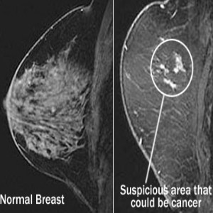
Who should get a screening MRI
Recommend Annual MRI Screening
BRCA mutation
First-degree relative of BRCA carrier
Lifetime risk ∼20–25% or greater Radiation prior to age 30
Notes:
Insufficient Evidence to Recommend for or Against MRI Screening‡
Lifetime risk 15–20%, as defined by BRCAPRO or other models that are largely dependent on family history
Lobular carcinoma in situ (LCIS) or atypical lobular hyperplasia (ALH)
Atypical ductal hyperplasia (ADH)
Heterogeneously or extremely dense breast on mammography
Women with a personal history of breast cancer, including ductal carcinoma in situ (DCIS)
Tyrer Cruzic- risk model dependent on FH

Slide 17
Risk reduction in high risk patients
Risk reduction surgeries: In patients with a genetic mutation
Endocrine therapy : Tamoxifen, raloxifene, or aromatase inhibitor for 5 years.
Prevents HR+ breast cancer by 50%, does not prevent HR- cancer
Most notable benefit is seen in Atypical hyperplasia
No known survival benefit.
Absolute benefit is small
Consider sending these patients to an oncologist for further evaluation and management.
Notes:
Raloxifen 76% EFFECTIVE compared to Tam
Reduced risk from 4/100 to 2/100

Slide 18
Breast cancer treatment overview
Management
Patient factors: Age, comorbidities, patient preferences
Tumor factors: Stage, receptors, biology
Early/ Locally advanced: Stages I-III
Surgery
Chemotherapy
Radiation
Endocrine therapy
Notes:
For the purposes of todays discussion will focus on some key changes in management of Localized breast cancer

Slide 19
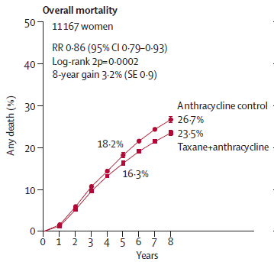
Localized breast cancer- Adjuvant chemotherapy
EBCTCG Lancet 2012
Notes:
Adjuvant chemotherapy saves lives in high risk breast cancer
The SOC in a fit patient is An anthracycline and taxane containing regimen given dd for a period of 5 months
Increasing use of Neoadjuvant chemotherapy in locally advanced disease, HER2 pos or TNBC
Individualize care based on genomic profiling, some patients with small tumors and < 3 nodes may be able to omit chemotherapy
Other than that, not a whole lot has changed on this front

Slide 20
Localized breast cancer: Adjuvant targeted therapy
HER2 positive disease
Traztuzumab given for a full year
BMC cancer 2007
Notes:
Where there are a couple of updates are in HER2 positive disease. We know that for HER2 positive disease.
adjuvant Traztuzumab improves survival- across the board

Slide 21
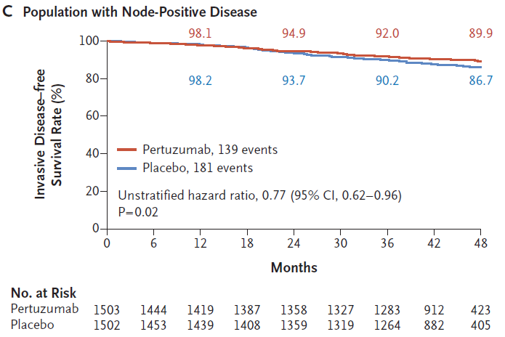
Adjuvant therapy- HER2+ updates
Adjuvant Pertuzumab
Neratinib:
Extended adjuvant therapy significantly reduced breast cancer relapses
Minckwitz et al NEJM 2017; Martin et al. Lancet Oncol 2017
Notes:
We may start seeing 1 year of adjuvant Perjeta with Herceptin for high risk ER negative and node positive breast cancer due to a benefit demonstrated in the APHINITY study. Does not increase cardiac toxicity but significantly increased grade 3 or more diarrhea. The ExtraNET study in addition showed benefit as regards invasive disease free survival with extended Neratinib at the cost of significant diarrhea

Slide 22
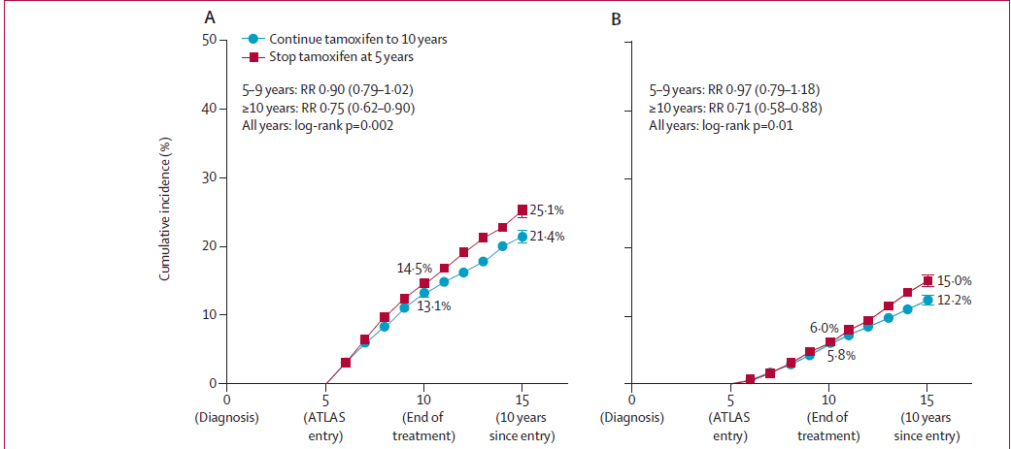
Localized disease: Adjuvant endocrine therapy
10 years of AI or Tamoxifen followed by AI
Davies et al. Lancet 2013
Notes:
2 main updates or points that I would like to go over are
Duration of endocrine therapy and endocrine therapy in HR younger patients
Attom, MA17 (LETROZOLE). The beneficial effects panned out after 10 years of diagnosis with an absolute risk reduction in recurrence of 4% and BC mortality of 2.8% for 10 vs 5 years of Tam.

Slide 23
Adjuvant endocrine therapy: Ovarian ablation (OFS)in high risk breast cancer
Role of ovarian function suppression – SOFT and TEXT
Women < 35 of age (94% received chemotherapy)
Treatment | 5 year DFS (CI)
Tamoxifen (T) | 67.7% (57.7-76)
Tamoxifen +OFS | 78.9% (69.8-85.5)
Exemestane +OFS | 83.4% (74.9-89.3)
Notes:
For high risk premenopausal women who are premenopausal after adjuvant chemo Exemestane + OFS improves outcomes compared to Tamoxifen.

Slide 24
Breast cancer – Long term care and survivorship

Slide 25
Estimated Numbers of US Cancer Survivors by Site
Notes:
This figure illustrates estimates for the 10 most common cancers among male and female survivors in 2014 and 2024. The most common cancer among male survivors is prostate cancer, followed by colorectal cancer and melanoma. Among female survivors, breast cancer is most common, followed by uterine and colorectal cancers.
The majority of cancer survivors (64%) were diagnosed 5 or more years ago, and 15% were diagnosed 20 or more years ago. Nearly half (46%) of cancer survivors are 70 years of age or older, while only 5% are younger than 40 years.
For breast cancer: The number of survivors estimated to go up to more than 3 million by 2024

Slide 26
Why is survivorship important?
Annual mortality rates are decreasing- 4/10 cancer survivors had breast cancer
61% have localized disease- 99% 5 year Relative Survival
43% older than 65
Must be managed with age associated comorbidities
Studies show that Generalist follow up more cost effective and no less effective than specialist follow ups

Slide 27
Aspects of Long term care & survivorship
Surveillance for breast cancer recurrence
Screening for second primary
Assessment and management of physical and psychosocial long term effects of treatment
Health promotion

Slide 28
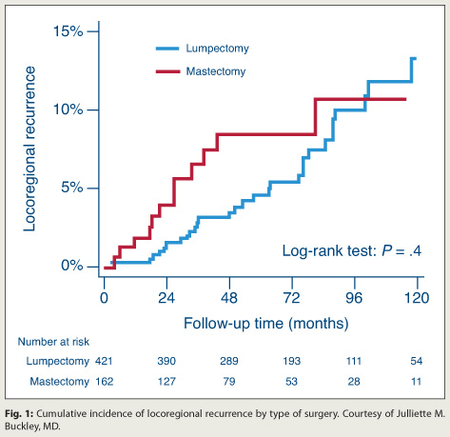
Surveillance for breast cancer recurrence- Local recurrences
In breast
Chest wall
Nodal
Notes:
Local recurrences occur earlier after mastectomy than after lumpectomy
With prolonged follow up- higher risk of local recurrence after BCT

Slide 29
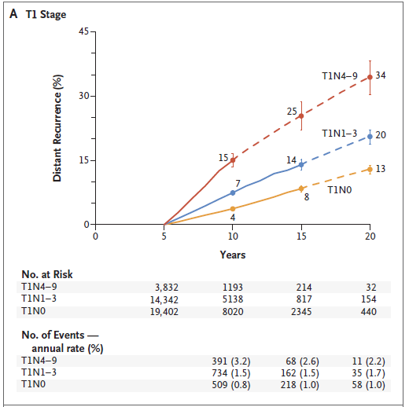
Surveillance for breast cancer recurrence- Distant recurrences
Pan H et al. NEJM 2017
Notes:
After stopping 5 years of endocrine therapy- risk of distant recurrence remains substantial
For example, even for T1N0 disease there is a 13% risk of distant recurrence During 5-20 years

Slide 30
Surveillance for recurrence: ACS and NCCN guidelines
Detailed H and P 1-4 times a year x 5 years, annually thereafter
Bilateral annual mammogram

Slide 31
Screening for second primary cancers
Second primary breast cancer
Risk of a second breast cancer is between 0.5 and 1.0 percent per year
Gynecologic cancers on SERM
Extended tamoxifen doubles the risk of and mortality from endometrial cancer
3.1 versus 1.6 percent
0.4 versus 0.2 percent respectively
Annual gynecologic exams

Slide 32
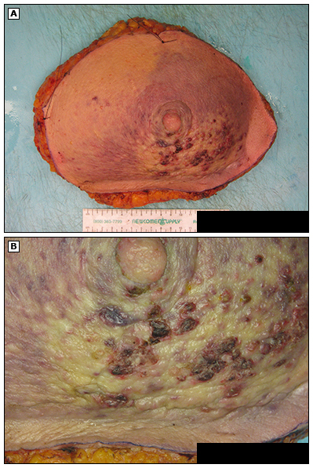
Other second primaries
Genetic susceptibilities
Shared exposures
Treatment adverse effects
Radiation: Sarcomas of the breast, shoulder, lung cancer
Surgery: Silicone Implant -anaplastic large cell lymphoma
Chemotherapy: MDS, Leukemia
Awareness for these is a shared responsibility of the Oncologist and PCP

Slide 33
Long term adverse effects
Cardiotoxicity
Vasomotor symptoms
Bone health
Neuropathy
Infertility
Fatigue
Cognition
Sexual health

Slide 34
Cardiac disease following breast cancer
Risk
The absolute risk of dying from CVD 1.6-10.4%
older age, Left sided, AA
Why?
Coexisting CV risk factors more prevalent
XRT
Anthracycline
Anti HER2 therapy
What could we do?
Identify patients at risk
Aggressive management of cardiac risk factors
Consider ECHO 1 year after Anthracyclines if additional CV risk factors
Gernaat et al. Breast cancer Res Treat 2017

Slide 35
Health Promotion
Achieve and maintain a healthy body weight
Healthy diet with vegetables, grains, fruits, low sugars
Minimize alcohol- no more than 1 drink per day
Vitamin D

Slide 36
The American Cancer Society Website cancer.org/treatment/survivorshipduringandaftertreatment/index
Notes:
To locate Society survivorship resources, visit cancer.org/treatment/survivorshipduringandaftertreatment/index to access survivorship resources to address topics from nutrition and physical activity to online communities and support, in addition to survivorship care plan templates listed in the American Cancer Society-Commission on Cancer Collaborative Action Plan Guide.

Slide 37
Community Resources
Helping you find the Power to Overcome...
so You Can! Live Well, Virginia!
https://ha.healthawareservices.com/ra/survey/2860
31st Annual National Cancer Survivors Day Sunday June 3, 2018
Notes:
Support groups, patient navigation, and counseling/bereavement services
The Legal Information Network for Cancer (LINC)
Outpatient nutrition counseling-available at SMH and SFCI
Smoking cessation—available to community via link on Bon Secours website
Art therapy, yoga and meditation coaching for Bon Secours cancer patients
Pet therapy
Stanford Chronic Disease Self-Management courses offered through the community through Senior Connections
Area Cancer Survivors Day celebrations—last year’s Bon Secours event hosted for the entire community of cancer survivors at the Redskins Training Facility
Cancer rehabilitation offered at Bon Secours Westchester Physical Therapy
CancerLINC—local non—profit providing legal assistance and financial counseling for Richmond cancer patients and their families

Slide 38
Thank you
Thank you

