Slide 1
Radiosurgery: From Brain to Body
J. Daniel Pennington, MD, PhD
Urological Update & More 2018

Slide 2
Disclosures
I am a practicing radiation oncologist

Slide 3
Objective
Indicate when patients should be considered for radiosurgery

Slide 4
Outline
A very brief history of radiosurgery
Cranial radiosugery
Body radiosurgery
Radiosurgery for lung cancer
Spinal radiosurgery
Oligometastatic disease

Slide 5
Stereotactic radiosurgery
Delivery of a single, high dose of irradiation to a small intra-cranial volume through the intact skull.
Invented in the 1950s in Sweden by Lars Leksell and others.
Lars Leksell (1907-1986) lgksociety.com

Slide 6
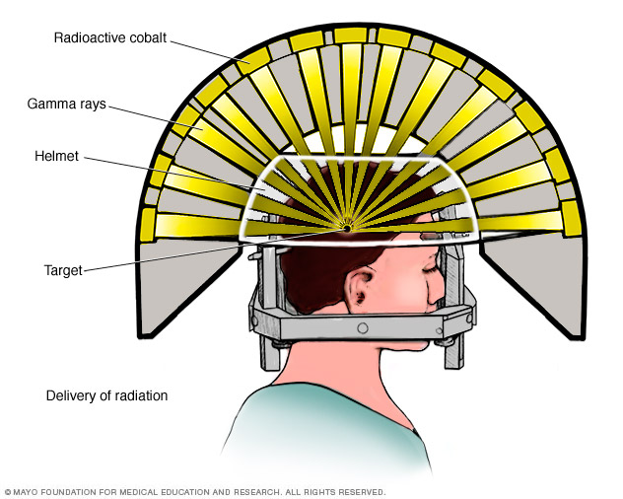
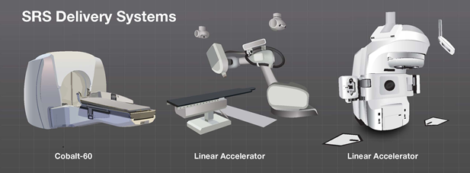
Stereotactic radiosurgery can be delivered effectively via several technologies
Examples include: Gamma Knife (Elekta) and multiple linear accelerator based platforms including TrueBeam (Varian), Novalis Tx (BrainLab/Varian), Cyberknife (Accuray), Versa HD (Elekta), and others.
(mayo.edu)
(brainlab.org)

Slide 7
Current indications for intracranial radiosurgery
Brain malignancy (often metastatic disease)
Benign tumors (meningioma, schwannoma, pituitary adenoma, etc.)
Vascular abnormalities (eg. Arteriovenous malformations)
Functional disorders (Trigeminal neuralgia, Parkinsonian tremor)

Slide 8
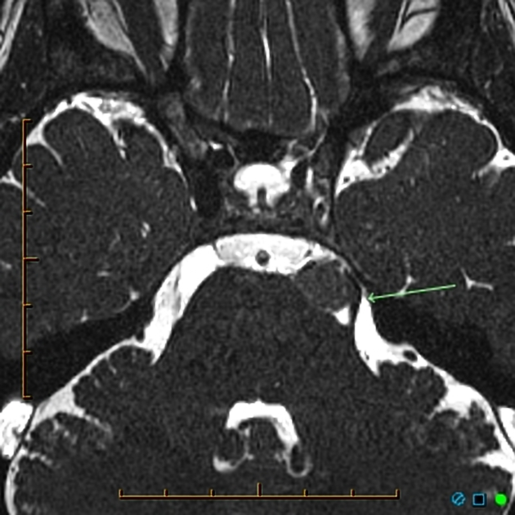
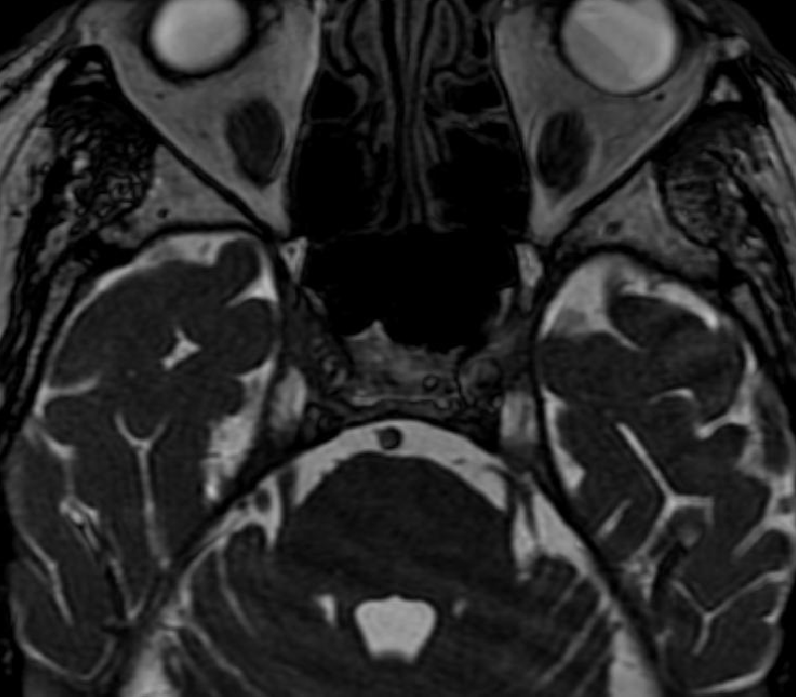
Trigeminal neuralgia
Neuroimaging to rule out secondary TN from demyelination from MS, or from mass effect.
1st line therapy of classical TN is medical management with adequate doses of appropriate meds (oxcarbazepine, baclofen, lamotrigine, etc).
If there is a vessel impinging upon the trigeminal nerve root, microvascular decompression is accomplished via craniotomy.
Radiosurgery delivered in a single treatment to the trigeminal nerve root results in good pain relief for approx 75% of patients.
Secondary TN caused by a petroclivus meningioma compressing the trigeminal nerve root (radiopaedia.org)
No secondary etiology
(headneckbrainspine.com)
Notes:
Classic trigeminal neuralgia is characterized by a unilateral, paroxysmal, lancinating pain in the distribution of the trigeminal nerve
Response rates are approx 75% by 3 months. About a third of patients notice improvement in pain within the first 24 h. About 30% of patients have a new permanent partial facial numbness.

Slide 9
SBRT/SABR
Improvements in imaging and precision of radiation delivery allowed the parallel development of SBRT in Sweden and Japan, with US clinical experience starting in the mid-late 1990s.
Stereotactic Body Radiation Therapy / Stereotactic Ablative Body Radiotherapy
Radiosurgery performed outside the cranium

Slide 10
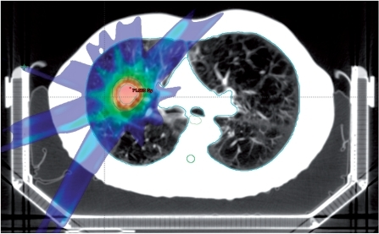
Lung SBRT
Radiation is precisely delivered to the lung tumor in 3 - 5 fractions* with excellent control rates.
Primary tumor control rate of 90 - 95%.
SBRT is the standard of care for medically inoperable early T1-2, N0 NSCLC.
The standard of care remains surgical resection for operable early-stage lung cancer patients.
(Høyer Cancer Imaging 2011)
*Common schema include 1, 3, 4, 5, 8, and 10 fractions depending on center and disease location.

Slide 11
Can we compare SBRT to surgical resection?
(It’s complicated.)

Slide 12
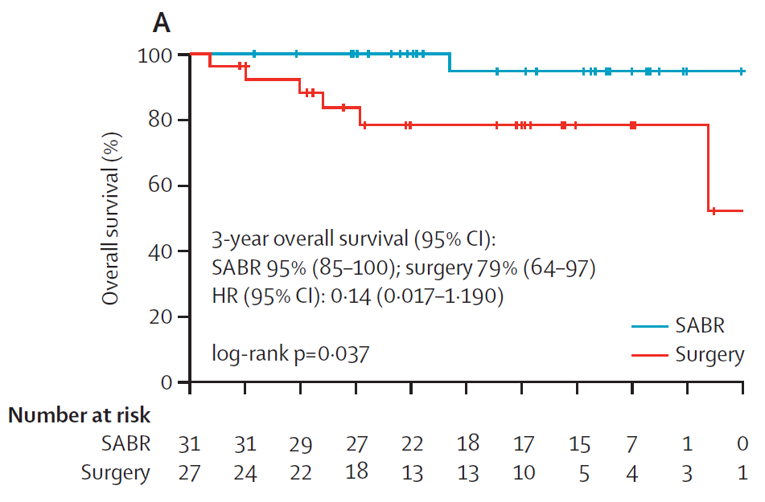
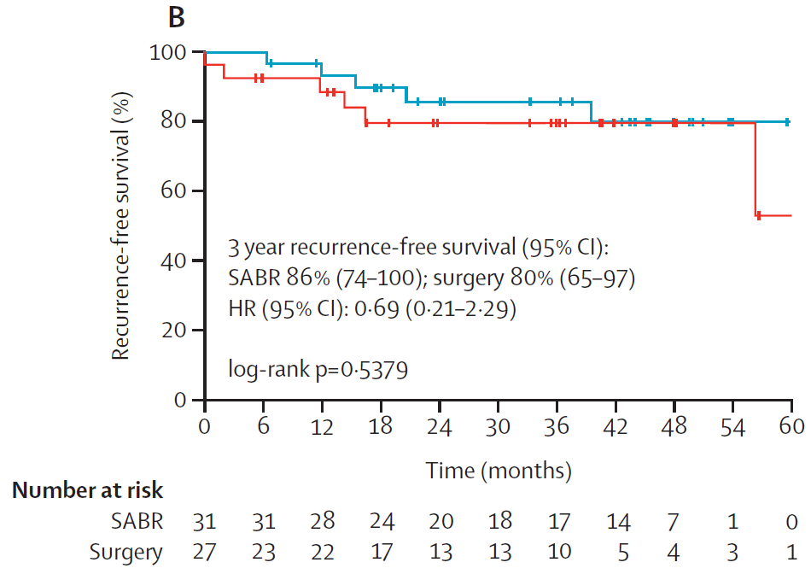
58 patients randomized for the STARS and ROSEL trials analyzed by Chang et al. (Lancet Oncol 2015)
Table: Joe Chang, MD, PhD
Notes:
One patient died and five had recurrence in the SBRT group compared with six and six in the surgery group.

Slide 13
The patient experience
Shaverdian et al (Lung Cancer 2015) surveyed 39 patients who had experienced both lung surgery and SBRT/SABR.
Compared to surgery, 100% reported an easier recovery, less treatment related anxiety and less caregiver strain with SBRT.
Overall, 79.5% were more satisfied with SBRT than surgery and 89.7% would have rather had SBRT than surgery as it was performed for their prior NSCLC.
Lung Cancer. 2015 Nov;90(2):230-3.

Slide 14
VALOR Trial
The VA is currently accruing a phase III trial to evaluate SBRT/SABR vs surgery in stage I NSCLC with an estimated enrollment of 670
PI: Drew Moghanaki, M.D., MPH
If your early stage lung cancer patients have VA access, please strongly consider referring to Dr Moghanaki and his colleagues at the VA!
ClinicalTrials.gov Identifier: NCT02984761

Slide 15
What about RFA?
Pooled analysis of 31 studies on SBRT (2767 patients) and 13 studies on RFA (328 patients).
Local control rates are superior for SBRT (above).
Most common severe (grade≥ 3) toxicity: RFA: pneumothorax that required intervention in 13% SBRT: radiation pneumonitis in 2% of patients
Int J Radiation Oncol Biol Phys, Vol. 95, No. 5, pp. 1378e1390, 2016

Slide 16
T1-2, N0 NSCLC
Surgery remains the standard of care for operable patients
SBRT/SABR is the standard of care for medically inoperable patients, or those who refuse surgery
Phase III data are needed and clinical equipoise supports randomization between surgery and SBRT/SABR
If your Stage I NSCLC patients have VA benefits, please refer to Drew Moghanaki!
Conclusions

Slide 17
Spine SBRT
Spinal metastases have long been treated with conventionally fractionated radiation
Stereotactic radiosurgery technique allows us to deliver an ablative dose to the tumor while sparing the spinal cord

Slide 18
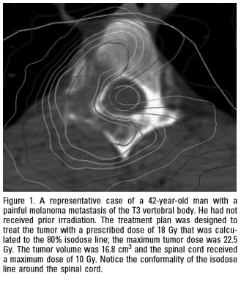
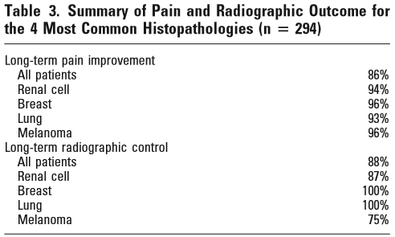
Spine SBRT
Excellent pain relief and long-term radiographic control. Figures: Gerszten Spine 2007
*Long-term = at last f/u, median 21 mo

Slide 19
SBRT for oligometastatic or oligoprogressive disease
There is increasing recognition of an oligometastatic state in some patients, suggesting definitive treatment to a small number of metastases may have survival benefits.
Similarly, patients treated with molecularly targeted agents may develop single or a few resistant clones which can potentially be treated definitively, allowing the patient to continue on the targeted agent.

Slide 20
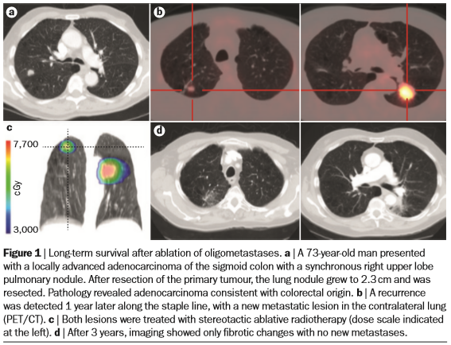
Oligometastatic colon cancer
Adenocarcinoma of the sigmoid colon with synchronous pulmonary metastasis in a 73 year old man.
Lung lesion resected, recurrence in bilateral lungs detected 1 year later.
Both lesions treated with SBRT, patient was NED 3 years later.
Palma et al. Nat Rev Clin Oncol. 2014 Sep;11(9):549-57.

Slide 21
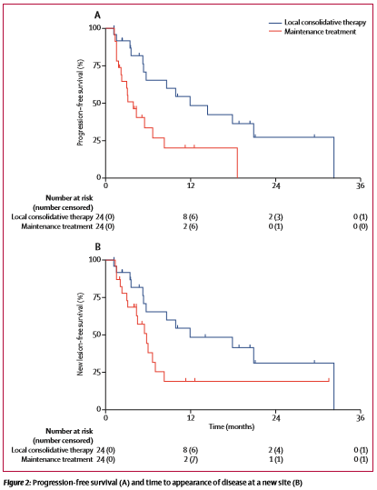
Can we select these patients appropriately?
Randomized phase II trial of NSCLC with up to 3 sites of metastatic disease.
49 patients with median f/u 12.4 months
SBRT or resection of all lesions vs. maintenance therapy.
Median progression-free survival in the local consolidative therapy group was 11·9 months versus 3·9 months in the maintenance therapy group.
A similar trial with up to 5 metastatic sites (Iyengar JAMA Onc 2017) showed comparable results: PFS 9.7 vs 3.5 months.
Gomez et al., Lancet Oncol. 2016 Dec;17(12):1672-1682.
Notes:
We don’t know what the precise number of metastases is that constitutes an oligometastatic state. Different trials have used different numbers.

Slide 22
NRG Oncology study BR002
This is a phase III clinical trial randomizing breast cancer patients with up to 2 non-CNS metastases to SBRT or surgery vs standard of care.
402 patients planned
Outcomes: progression-free survival, overall survival
The closest centers with this trial open are Duke and U Maryland.
ClinicalTrials.gov Identifier: NCT02364557

Slide 23
SBRT for oliogmetastatic disease is very promising, but more data is needed.

Slide 24
Thank you.
Questions?

