Slide 1
Fecal Microbiota Transplantation
For C.Diff Associated diarrhea and beyond
Ramy Eid, MD
Gastrointestinal Specialists, Inc

Slide 2
Introduction and Definitions
Gut microbiota
Evolution and role
Immune system function
Gut homeostasis
Symbiosis
Dysbiosis
C. difficile infection (CDI)

Slide 3
Normal intestinal flora
Human colonic microbiota
100 trillion bacteria (plus fungi, viruses)
500-1000 different species
60% of stool volume is bacteria
Normally protects against invasive pathogens, infection,
Produce vitamins
Assist in digestion of non-digestible fiber
Maintain colon health through production of free fatty acids
Modulate the colonic immune system

Slide 4
C.difficile infection
Exposure to C. difficile spores
Exposure to antibiotics
Germination and colonization of the spores and vegetative outgrowth
Expression of the toxins A and B
Epithelial damage and symptomatic infection

Slide 5
C. difficile infection
Self limited
Diarrhea, leukocytosis, fever, or pseudomembranous colitis
Limited to one course of antibiotics
Recurrent or relapsing C.difficile infection
Severe and fulminant disease
Ileus, megacolon, lactic acidosis, renal failure, septic shock, death

Slide 6
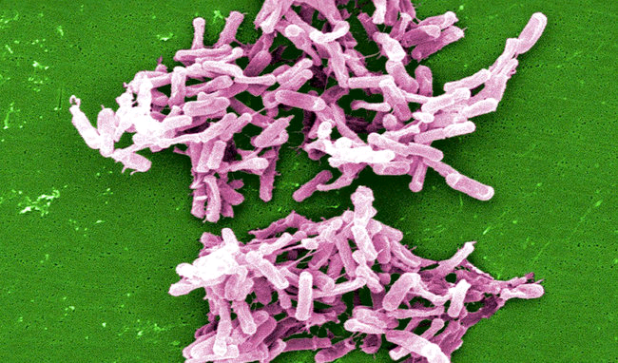
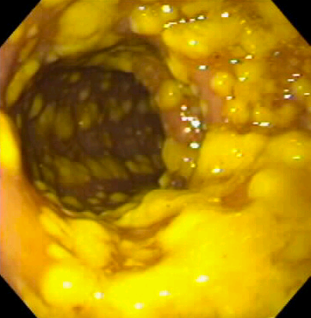
C. Diff has become more drug-resistant & more deadly

Slide 7
C. difficile infection Risk factors
Recent antibiotic intake
Age over 65
Recent hospitalization
Proton pump inhibitors use
Underlying medical disorders, renal insufficiency
Concomitant antibiotics during treatment for C.difficile infection
Lack of antibody-mediated immune response to toxin B

Slide 8
Epidemiology
Most common infectious cause of healthcare-associated diarrhea
At least half a million infections a year
Over 83,000 experienced at least one recurrence
Close to 30,000 death per year
Transmission of spores, resistant to heat, acid, antibiotics and most surface cleaners, except bleach
Now more than ¼ are community acquired
Increased healthcare cost: $1.5 billion dollars per year

Slide 9
C.difficile infection Treatment
Antibiotics
Mild to moderate disease
Oral antibiotics
Metronidazole
Vancomycin
Fidaxomicin
Severe Disease
Oral vancomycin and IV metronidazole
Oral fidaxomicin
Recurrent or relapsing disease
Pulsed oral antibiotic therapy
Fecal microbiota transplantation
More aggressive and virulent strains are developing
Increasing number of infections

Slide 10
What is FMT
Transfer and implantation of stool and bacteria from the colon of a healthy person to the colon of a person with a certain disease to affect the cure of that disease.

Slide 11
FMT Rx Guidelines 2018
ACG: American College of Gastroenterology
IDSA: Infectious Diseases Society of America
SHEA: Society for Healthcare Epidemiology of America
ESCMID: European Society of Clinical Microbiology and Infectious Diseases
WSES: World Society of Emergency Surgery
ASID: Australasian Society for Infectious Diseases

Slide 12
Indications for FMT
≥ 3 Recurrences of mild/moderate CDI and failure to respond to standard Rx
≥2 Episodes of CDI resulting in hospitalization and significant morbidity
Moderate CDI with no response to standard therapy for at least 1 week
Severe CDI with no response to standard therapy after 48 hours

Slide 13
Donor selection
Intimate
Friend
Unrelated volunteer
Over the age 18
Family members
Men preferred over women? (autoimmune diseases, IBS)
Pre-screened healthy donor pool

Slide 14
Donor screening
Use same exclusions as for blood product donation
Screen donor for any illness – generally want someone who is healthy and on no medications
Screen for hepatitis A, B, C, HIV, H.pylori, syphilis, C.difficile, Giardia, E.coli, Salmonella, Shigella, Campylobacter infections
Can be an individual familiar to the patient or familiar to the MD

Slide 15
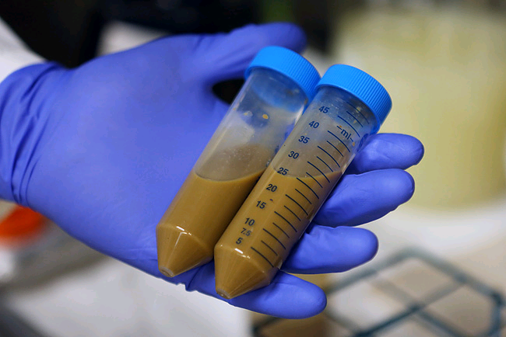
Stool preparation
Stool is collected from the donor, processed to create a liquid suspension in water, filtered for large particulates
Stool can be frozen and used later with similar efficacy

Slide 16
Administration
Small bowel upper endoscopy to the jejunum
Nasojejunal tube placement
Colonoscopy
Retention enemas
Oral capsules

Slide 17
OpenBiome
Frozen stool from universal donor(s)
Stool bank
Upper, lower, capsules (30)

Slide 18
Clinical scenario Product/Route
Typical recurrence
Toxic megacolon/Ileus
Aged, infirm, incontinent
Lower, upper, capsules
Multiple lower ± upper
Upper

Slide 19
Safety of FMT
SHORT-TERM
Risk of aspiration if not delivered deep into upper small intestine
Risk of acquiring infection from donors – rare, single case reports
Risk of complications from sedation and endoscopy – bleeding, perforation, transmission of other infections: 1/1000-1/10,000
Does not impact liver transplantation screening or status

Slide 20
Safety of FMT
LONG-TERM
Complex interplay between gut microbiome and host
Risk of developing conditions of the donor?
Intestinal microbiota has been associated with colon cancer, diabetes, obesity and atopic disorders

Slide 21
Efficacy data in CDI
Success rates depend slightly on route of delivery
Enema → 80-85%
Upper GI → 80-85%
Colonoscopy to the right colon → 90-95%
Usually see control of diarrhea symptoms within 48-96 hours
MGH study, open label, relapsing C.Dff
15 frozen pills, orally over 2 consecutive days
90% response rate

Slide 22
Frozen Fecal Material
Randomized trial : 219 patients
6 Canadian academic medical centers
Frozen/thawed vs fresh stool for R-CDI
Frozen Fresh
Per-protocol analysis 83.5% 85.1%
Advantages of frozen FMT:
Availability, efficacy, safety, cost, data collection
Lee CH, et al. JAMA 2016

Slide 23
FMT: Fresh, Frozen, or Lyophilized (RDBCT of 72 pts with R-CDI
 | Cure Rates | Microbial diversity Reconstitution
Fresh | 100% | By Day 7
Frozen | 83.3% | By Day 7
Lyophilized | 69.6% | By Day 30
Overall | 87%
Jiang, et al. Aliment Pharmacol Ther 2017

Slide 24
Public Stool Bank* 2050 pts from 633 health care facilities 50 States, 7 countries
CDI | Clinical Cure | Upper (30 ml) | Lower (250)
 |  | n= 15% | n= 85%
Recurrent (1542) | 85.9% | 79.5% | 87.0%
Severe (90) | 83.3% | 88.0% | 81.5%
Mixed (259) | 79.2% | 66.7% | 80.0%
Refractory (159) | 74.2% | 69.7% | 75.4%
Overall | 84% | 74.1% | 85.8%
42 AEs, none definitely related to FMT
*OpenBiome, Medford, MA
Poster 2120:Osman, et al. ID week 2016

Slide 25
FMT Capsules
Author | Dose | #Patients | Cure
Louie, et al | 24-34 caps | 27 | 100%
Youngster, et al | 30 caps (15 x 2d) | 180 | 91%
Khanna, et al |  | 15 | 93%
Allegretti, et al | 30 caps | 24 | 94%
Hirsch, et al | 6-22 caps | 19 | 88%
Staley, et al |  | 49 | 88%
ID week 2013
BMC Med 2016
JID 2016
DDW 2016
BMC Infect Dis 2015
Am J Gastro 2017

Slide 26
Primary Cure Rates of FMT for CDI Meta-analysis (18 studies, 611 patients)
91.2% Overall
Lower: 93.2%
Upper:81.8%
Younger: 99.4%
Older: 87%
Li, et al. Aliment Pharmacol Ther 2016

Slide 27
Recurrence Rates of FMT for CDI Meta-analysis (18 studies, 611 patients)
Recurrence Rates
5.5% Overall
Lower:6.0%
Upper:8.2%
Younger: 4.6%
Older: 9.3%
Li, et al. Aliment Pharmacol Ther 2016

Slide 28
FMT for R-CDI 37 studies (7 RCTs and 30 case series)
FMT was more effective than vancomycin
Clinical resolution rates (all studies): 92%
Lower tract FMT more effective than upper tract FMT
No difference between efficacy of fresh and frozen stool
Consecutive FMTs after failure of First FMT ====> Incremental effect
Serious AEs are uncommon

Slide 29
How often does CDI recur after FMT?
Author | Year | Recurrence Rate | # Patients | Mean Interval
Brandt, et al | 2012 | 10% | 8/77 | 17 months
Khanna, et al | 2015 | 10.5% | 25/238 | 14 months
Fischer, et al | 2016 | 10.5% | 16/152 | 16 months
After FMT, long term rates of R-CDI with antibiotic use is low
But not as low as without antibiotics.

Slide 30
Predictors of failure after FMT for R-CDI
Advanced age
Underlying disease (COPD, renal failure…)
Hospital acquisition
Inpatient status
Severe/complicated CDI
Immunocompromised
Maximum WBC during R-CDI
Administration of antibiotics during R-CDI
PPI use

Slide 31
Role for Probiotics to prevent R-CDI
May be effective at preventing CDI in pts on abx without history of CDI
Rx with probiotics closer to the first dose of abx decreases the risk of CDI by 50% in hospitalized patients
There is insufficient data to recommend probiotics for primary prevention of CDI
There is potential risk for probiotics to cause disseminated infections in hospitalized patients

Slide 32
FMT in severe, complicated CDI
57 consecutive inpatients
91% (52/57) clinical cure at 1 month
No difference between fresh and frozen fecal material
No SAEs
Patients with severe or fulminant CDI and extensive pseudomembranes tend to respond poorly to a single FMT when anti-CDI antibiotics were held
53% pts cured by single FMT
28% pts needed 2 FMTs
11% pts required ≥ 3 FMTs
Sequential FMT for severe or complicated CDI is promising and may be preferred over colectomy in certain patients

Slide 33
FMT in Diseases other than Clostridium difficile

Slide 34
FMT in inflammatory bowel disease
Dysbiosis characterized by decreased diversity of species
Decreased Bacteroidetes phylum and Lachnospiraceae
Increase in Proteobacteria and Actinobacteria
Low levels of Faecalibacterium prausnitzii
Mixed results so far
Quality of studies
Variety of patient population
Concomitant medications

Slide 35
FMT in inflammatory bowel disease
UC patients less likely to achieve clinical remission
Meta-analysis: 45% clinical remission rate
Younger patients
Crohn’s disease
Short-term effect?
Side effects: bloating, flatulence, vomiting, diarrhea, abdominal tenderness
Flares have been described

Slide 36
FMT in inflammatory bowel disease
75 patients with UC , randomized to weekly FMT or water enemas for 6 weeks
24% achieved remission
5% with placebo
50 patients: Donor FMT or autologous FMT
No statistically significant difference in clinical or endoscopic remission

Slide 37
FMT in Obesity
Role of gut microbiome in obesity
Transfer of gut microbiota from lean and obese in ex-germ free mice
Antibiotic treatment in early life can predispose to obesity in animal models
Transfer following Roux-en-Y gastric bypass → Weight loss
Greater amount of short chain fatty acids in lean mice
Increase neuro-hormonal axis: Increase energy expenditure
Improved insulin sensitivity

Slide 38
FMT in irritable bowel syndrome
Decreased microbial diversity
Early studies reported improvement
Small, uncontrolled series with high risk of bias

Slide 39
FMT in other indications
Metabolic syndrome
Type II diabetes
Fatty liver disease
Multidrug resistant organism eradication
Hepatic encephalopathy
Pediatric allergy disorders
Association ≠ Causation

Slide 40
Regulatory issues
Worldwide variation
Australia and Europe no regulation so far
Canada: FMT “New Biologic Drug”
FDA: Biological product
Donor eligibility, stool processing and infusion, fall under FDA jurisdiction

Slide 41
Thank You

